Slide 1
Cloud Watch
Amazon CloudWatch is a web service that enables you to monitor, manage, and publish various metrics, as well as configure alarm actions based on data from metrics.
Amazon CloudWatch monitors your Amazon AWS resources and the applications you run on Amazon AWS in real time.
You can use CloudWatch to collect and track metrics, which are the variables you want to measure for your resources and applications.
CloudWatch alarms send notifications or automatically make changes to the resources you are monitoring based on rules that you define.
Basic monitoring data about every 5min.
Detail Monitoring works with every 1min apart from every thing same.
Cloudwatch provide the various metrics and key aspects.
Key aspects provides Alarms.
Amazon CloudWatch provides a reliable, scalable, and flexible monitoring solution that you can start using within minutes.
You no longer need to set up, manage, and scale your own monitoring systems and infrastructure.
Use CloudWatch Events to send system events from AWS resources to AWS Lambda functions, Amazon SNS topics, streams in Amazon Kinesis, and other target types.
Use CloudWatch Logs to monitor, store, and access your log files from Amazon EC2 instances, AWS CloudTrail, or other sources.

Slide 2
Metrics :
Metrics are data about the performance of your systems.
Metric data is kept for a period of 15 months, enabling you to view both up-to-the-minute data and historical data.
A system or standard of measurement.
CloudWatch Alarms:
You can create a CloudWatch alarm that watches a single metric.
The alarm performs one or more actions based on the value of the metric relative to a threshold over a number of time periods.
Alarm triggers one or more actions based on the value of monitor matric.
Alarm States:
OK— The metric is within the defined threshold
ALARM— The metric is outside of the defined threshold
INSUFFICIENT_DATA— The alarm has just started, the metric is not available, or not enough data is available for the metric to determine the alarm state
Logging:
Recording of performance,events, or day-to-day activities.

Slide 3
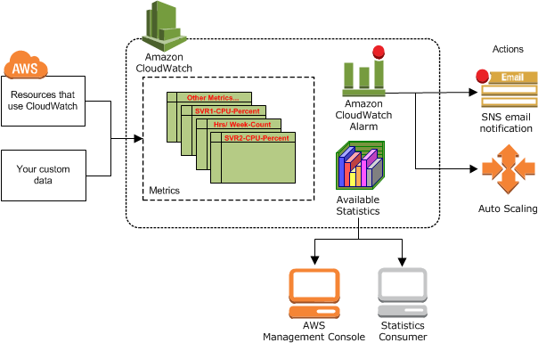

Slide 4
CloudWatch Events:
Based on sudden rules event can be trigger.
Amazon CloudWatch Events delivers a near real-time stream of system events that describe changes in Amazon Web Services (AWS) resources.
Using simple rules that you can quickly set up, you can match events and route them to one or more target functions or streams.
You can also use CloudWatch Events to schedule automated actions that self-trigger at certain times using cron or rate expressions.
Events—An event indicates a change in your AWS environment. AWS resources can generate events when their state changes.
Targets—A target processes events. Targets can include Amazon EC2 instances, AWS Lambda functions.
Rules—A rule matches incoming events and routes them to targets for processing.
A single rule can route to multiple targets, all of which are processed in parallel.
Schedule Expressions for Rules:
You can create rules that self-trigger on an automated schedule in CloudWatch Events using cron or rate expressions.
All scheduled events use UTC time zone and the minimum precision for schedules is 1 minute.

Slide 5
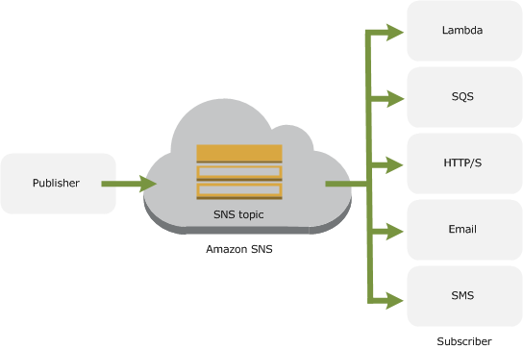
SNS
Amazon Simple Notification Service (Amazon SNS) is a fast, flexible, fully managed push messaging service.
To get started with Amazon SNS, developers first have to create a topic, which is an access point for subscribers who are interested in receiving notifications about a specific subject.

Slide 6
Topic:
A topic is a communication channel to send messages and subscribe to notifications.
It provides an access point for publishers and subscribers to communicate with each other.
Subscribe to a Topic:
To receive messages published to a topic, you have to subscribe an endpoint to that topic. An endpoint is a mobile app, web server, email address, or an Amazon SQS queue that can receive notification messages from Amazon SNS.
Once you subscribe an endpoint to a topic and the subscription is confirmed, the endpoint will receive all messages published to that topic.

